Slide 1
Heritage Month at St. Camillus
Event Report and Reconciliation, October 2026
Volunteer coordinator: Ian Woodward
Committee lead: Father Michael Donovan | Music: Rosa Hamilton
Parish hall and church, Silver Spring

Slide 2
THE EVENING
Program and People
Time | Segment | Lead
5:00 PM | Welcome and blessing | Father Michael Donovan
5:20 PM | Choir performance, four pieces | Rosa Hamilton
5:45 PM | Community potluck | Volunteer team
6:30 PM | Children's art display | Lucy and choir parents
7:15 PM | Closing remarks | Father Michael Donovan
Volunteer teams
Team | Lead | Contribution
Setup and teardown | Carl Marsden | Hall staging and cleanup
Music | Rosa Hamilton | Four pieces in harmony
Children's program | Choir parents | Art display and ornaments
Coordination | Ian Woodward | Scheduling and reconciliation

Slide 3
GENEROSITY
Where the Giving Came From
Total net to parish
$3,827.04
Crypto pricing was cross-checked across three venues with variance under one percent before posting.
All figures approved at the monthly committee close.

Slide 4
THE NUMBERS
From Donations to Ministries
Total net donations
$3,827.04
Less expenses
$435.00
Net to ministries
$3,392.04

Slide 5
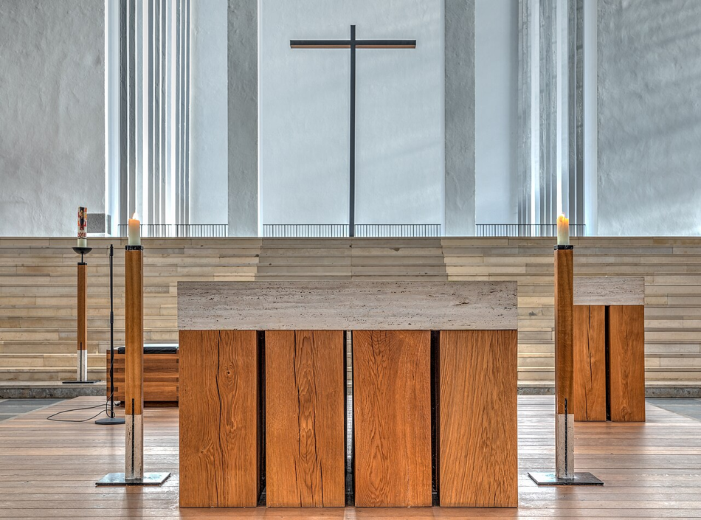
WHY WE DO THIS
More Family Than Hobby
Setup and teardown, the kitchen, the choir loft, the children's art table. Every part of the evening was carried by people who showed up for one another.
None of us could do this alone. We do it because other people showed up for our families first, and we pay it back the same way.

Slide 6
WHAT COMES NEXT
Carrying the Roster Forward
• Carry the volunteer roster forward to the Christmas concert on 2026-12-15
• Refresh the parish gift shop stock for the Advent season
• Send thank-you notes through the parish newsletter
• Start volunteer signups two weeks earlier next year
• Pre-order paper goods to reduce day-of cost
We prepare the best we can, and then we pray.
With gratitude, the Heritage Month Planning Committee looks forward to the Advent season and the annual Christmas concert.

